Slide 1
MetSolution tutorial
Aug 29th 2019

Slide 2
URL
metda.fiehnlab.ucdavis.edu
Recommended to use Chrome browser for MetSolution.
The MetSolution is currently under development and will be submit for peer review in Oct 2019.
Any question/recommendation, please feel free to contact slfan@ucdavis.edu.

Slide 3
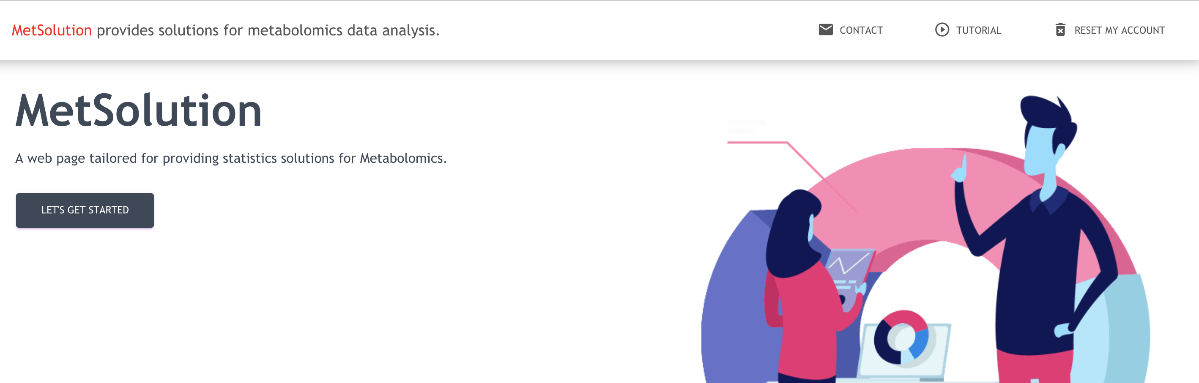
Home page
When you enter the URL in the Chrome browser, you will be redirect to this home page.
* Click Reset My Account: MetSolution will reset its every settings associated with your browser. When you click, you’ll lose all the projects. This is for the purpose of debugging.

Slide 4
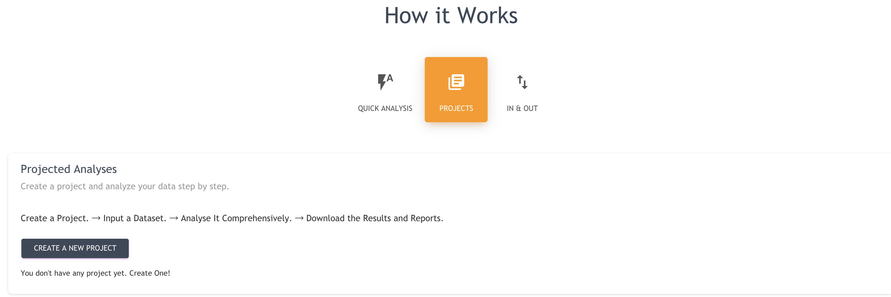
How it works
There are three ways of using MetSolution.
In & Out: select statistics you need, upload dataset, submit, and download result
Project: Upload a dataset, and start a series of statistical analysis
* Quick Analysis: Apply a Statistical analysis Pipeline you did before to a new dataset.
*Not yet available. Will be ready on October 2019.

Slide 5
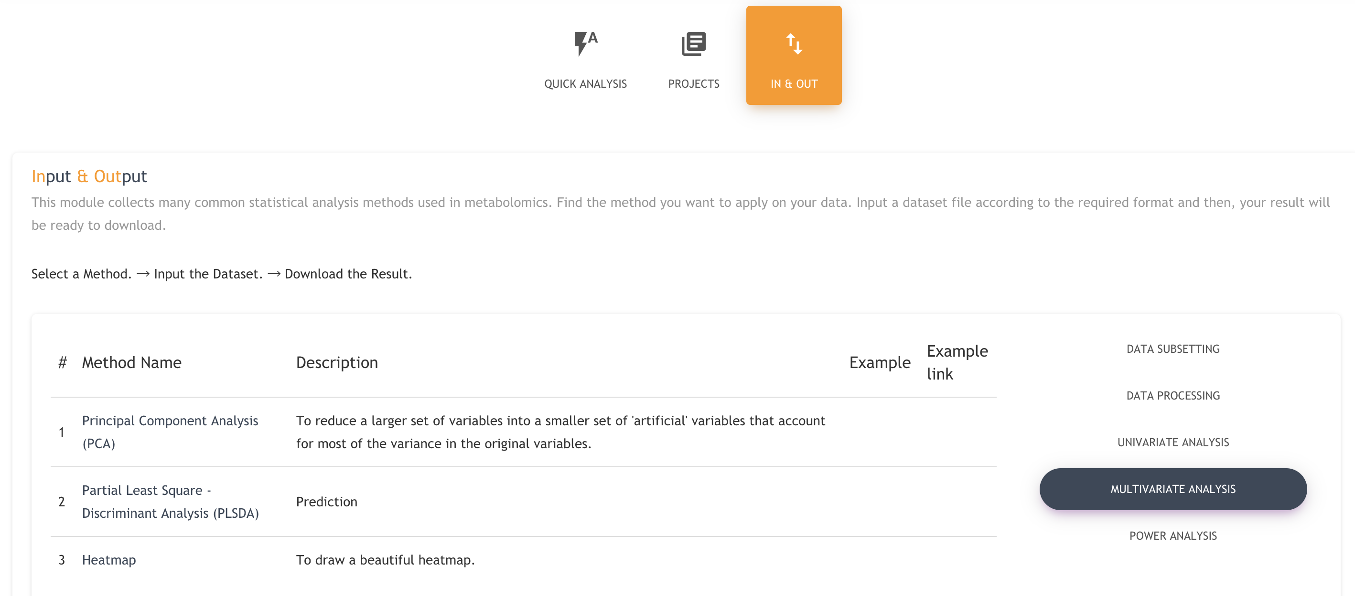
In & out
Example: Principal Component Analysis
Click In & Out [as shown in the right figure]
Click Multivariate Analysis
Click Principal Component Analysis

Slide 6
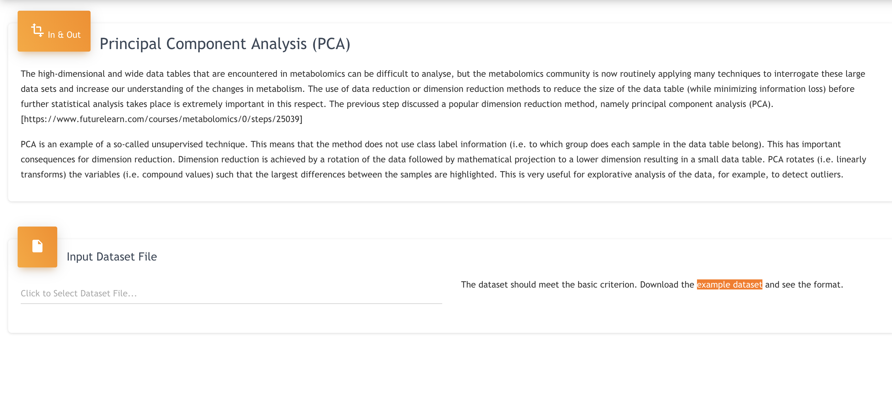
In & out
Example: Principal Component Analysis
* Click example dataset to download the dataset and see the format requirement.
Click “Click to Select Dataset File…” to upload dataset.

Slide 7
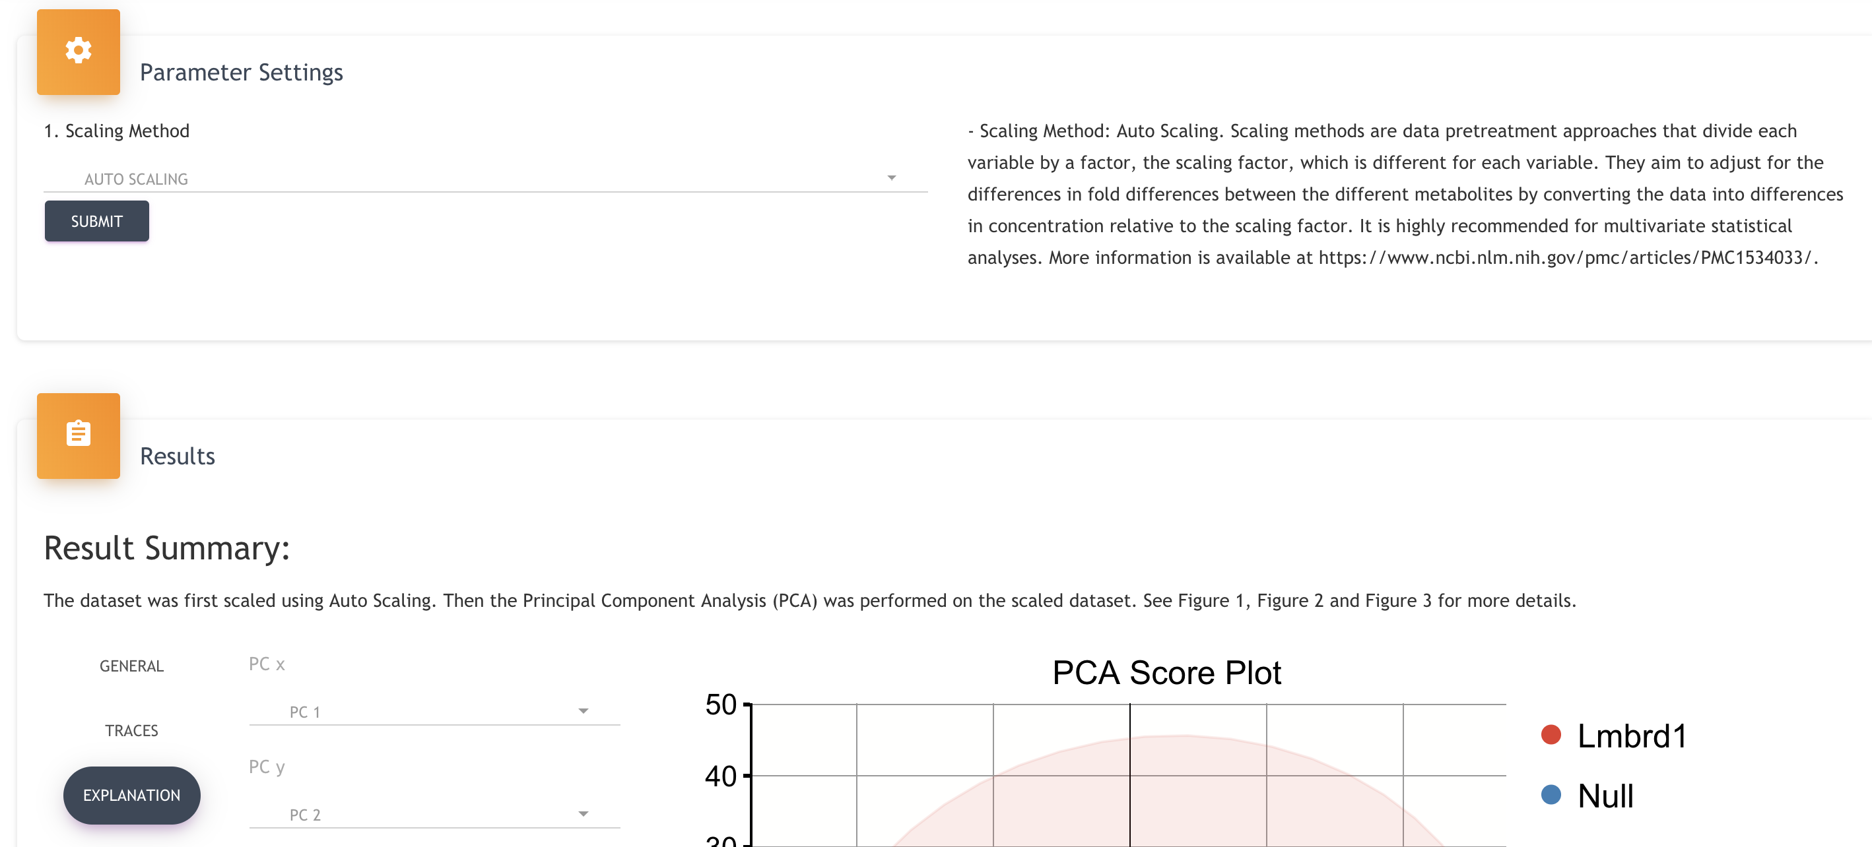
In & out
Example: Principal Component Analysis
Click “SUBMIT” to start calculation.

Slide 8
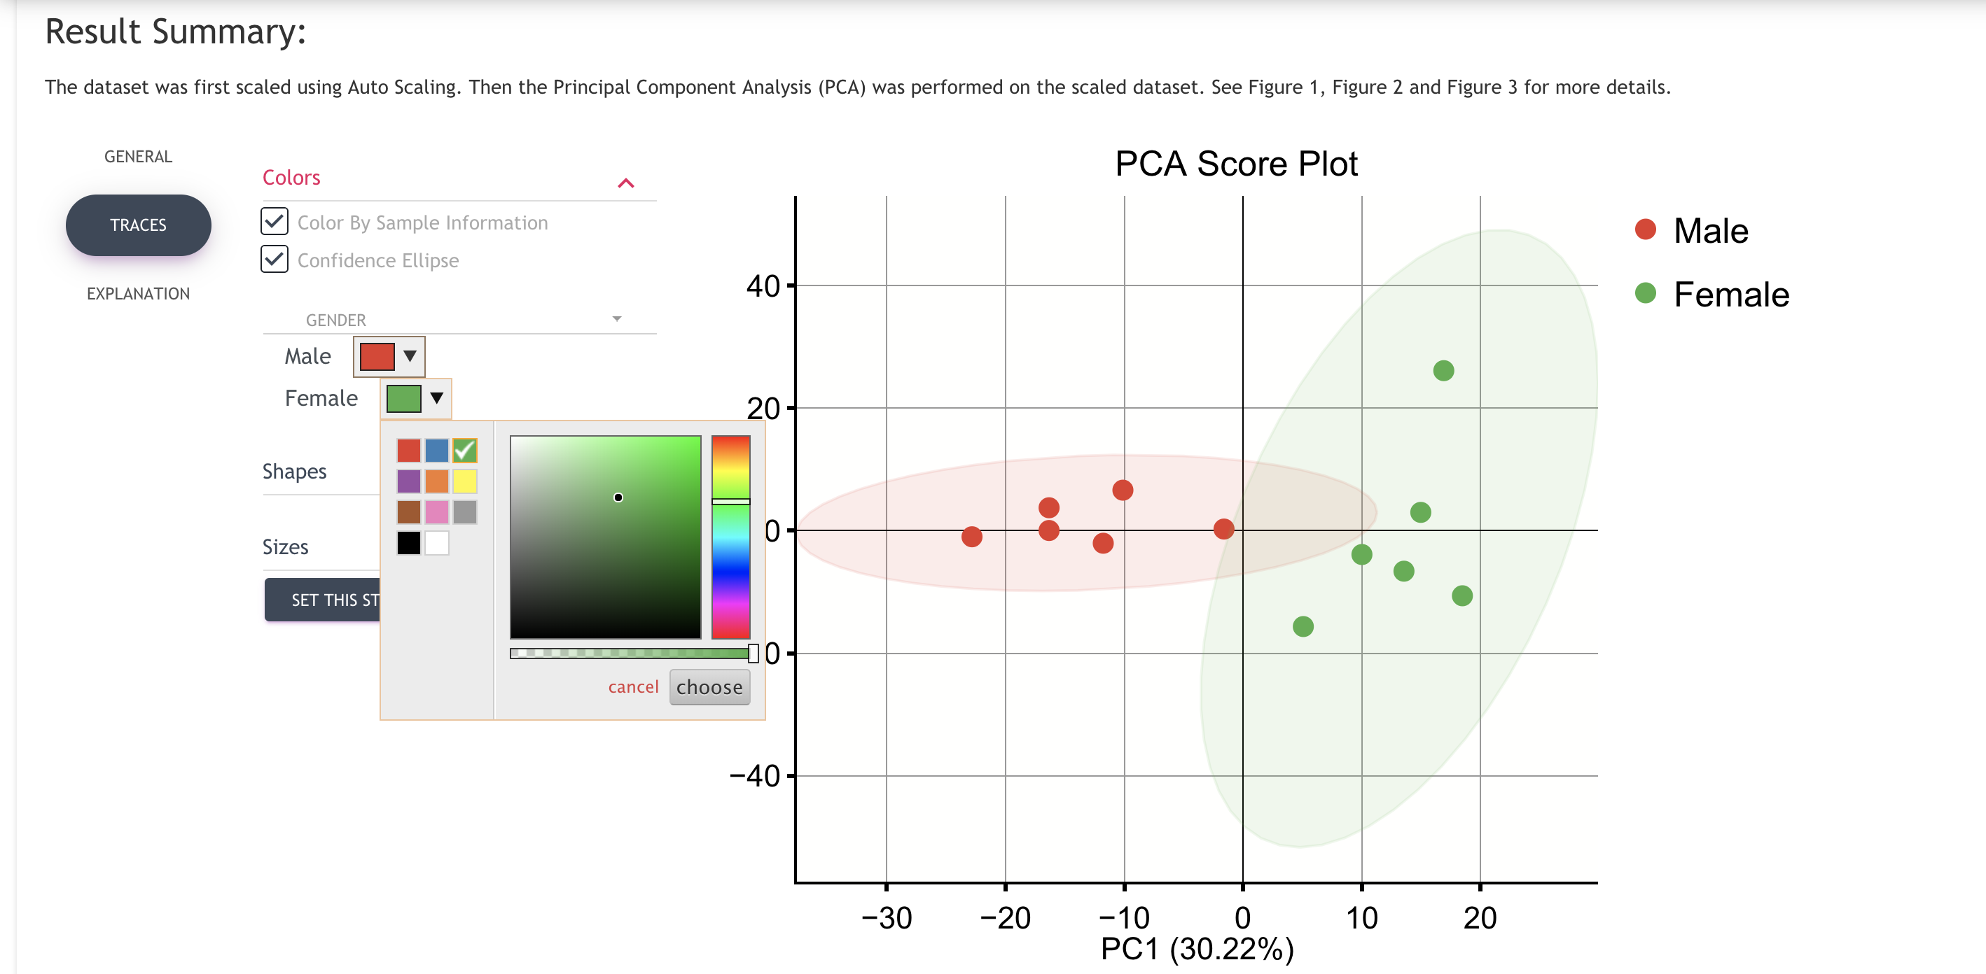
In & out
Example: Principal Component Analysis
To adjust the color, font size, etc
Click “TRACES” or “GENERAL” to adjust figure.

Slide 9

In & out
Example: Principal Component Analysis
Click to Download Results

Slide 10
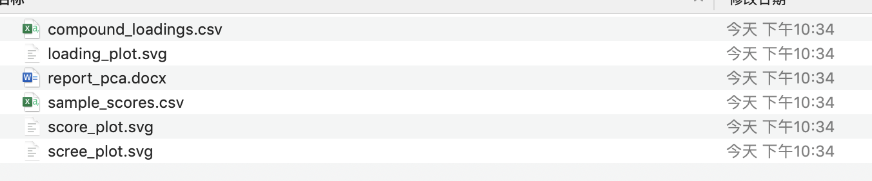
In & out
Example: Principal Component Analysis
Results Downloaded including
Figures*, Tables, and a Report.

Slide 11
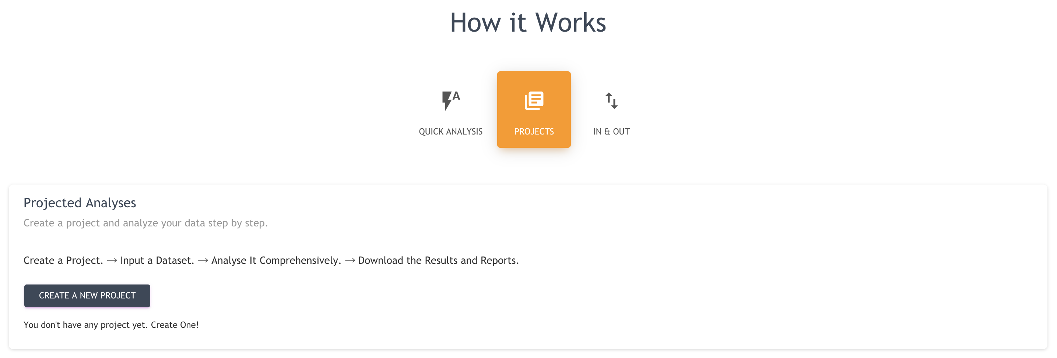
PROJECTS
Now we will upload a dataset, create a project, and start statistical analyses.
Click “CREAT A NEW PROJECT”

Slide 12
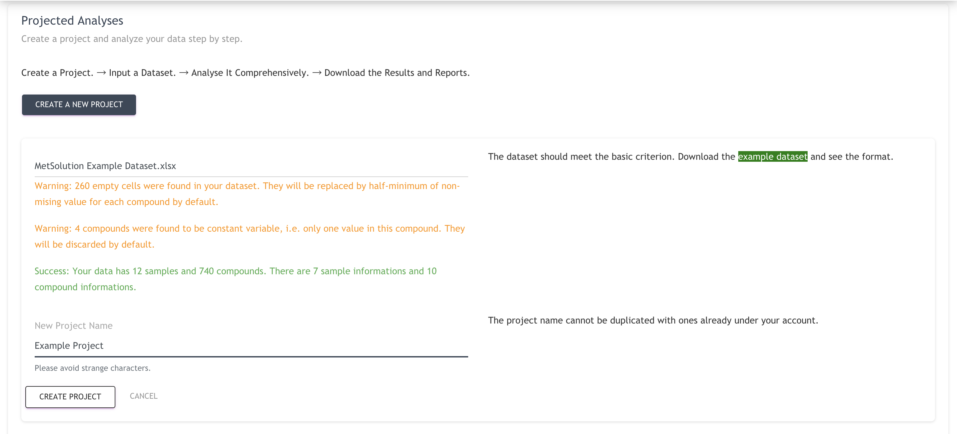
PROJECTS
Now we will upload a dataset, create a project, and start statistical analyses.
Click “CREAT A NEW PROJECT”
Download example dataset
Upload a Dataset
Give a New Project Name: ExampleProject (cannot have blank in the project name)

Slide 13
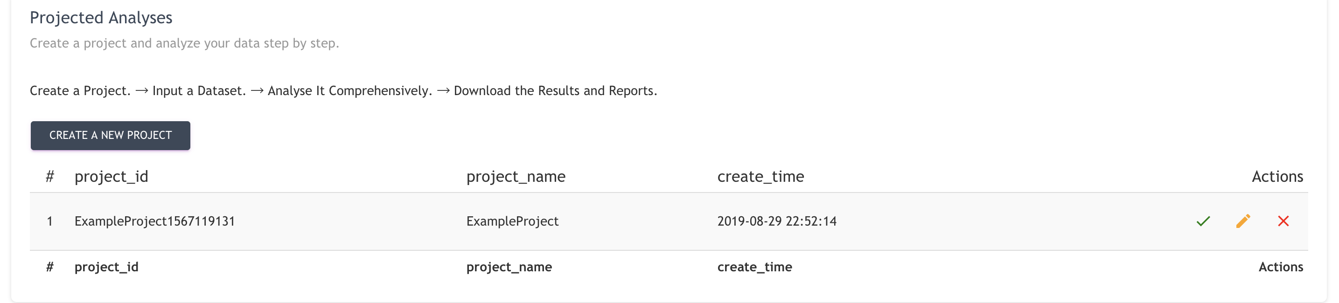
PROJECTS
Now we will upload a dataset, create a project, and start statistical analyses.
After the project is created, a project table will be shown. Click the green check icon to select this project and go into this project to start statistical analyses.

Slide 14
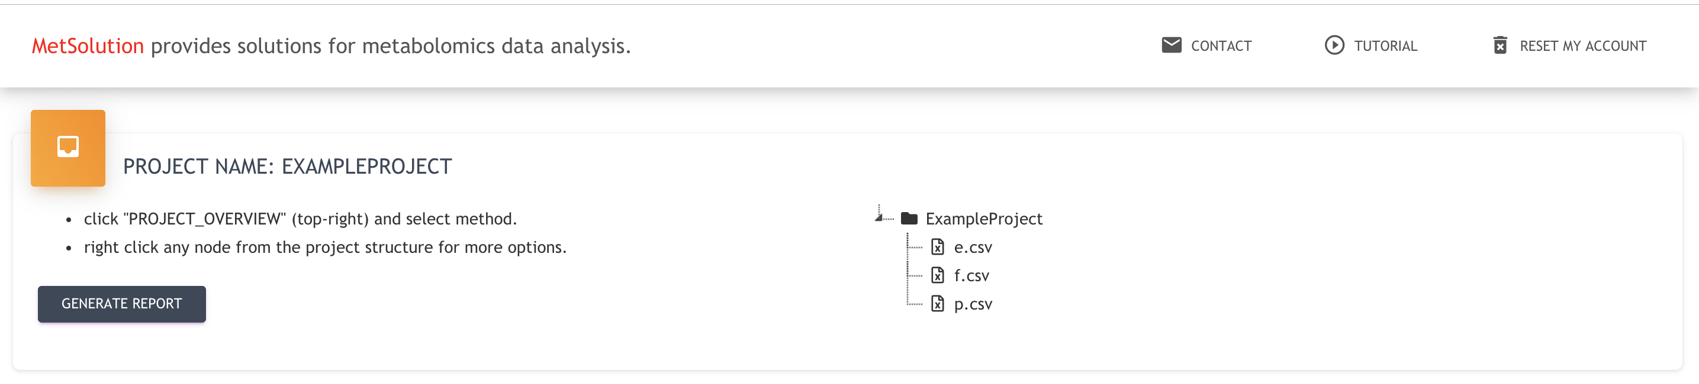
PROJECTS
Here is the project structure.

Slide 15
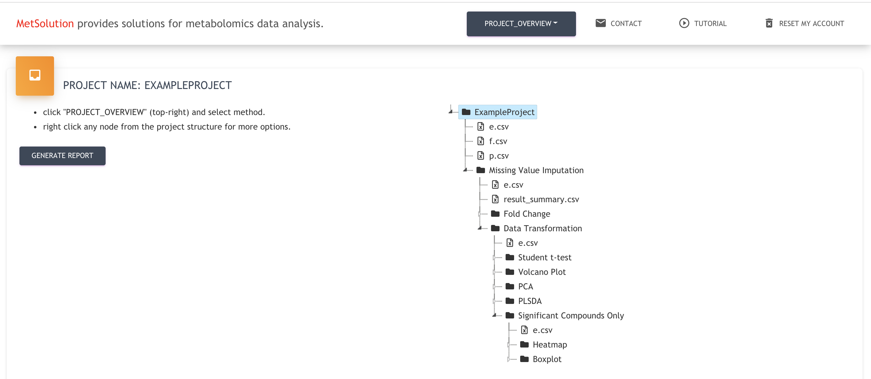
PROJECTS
We would like to perform several Statistical Analyses.
The result structure would be like the right figure.
PLEASE SEE THE VIDEO TUTORIAL (https://youtu.be/vmTf0dfFnqM)

Slide 16
Thank you!
If any question/suggestion/collaboration, please feel free to contact slfan@ucdavis.edu
Official version will be submit on October 2019.

